Slide 1

Introduction
Objective: Persuade a leadership team member with an Analytical Social style to support the purchase
Photo by Aileni Tee on Unsplash

Slide 2

Decision-Maker Profile
Position: Project Director
Social Style: Analytical
Key Characteristics: Information-oriented, good planner, systematic worker, values organized and logical processes
Photo by Sherwin Torres on Unsplash

Slide 3
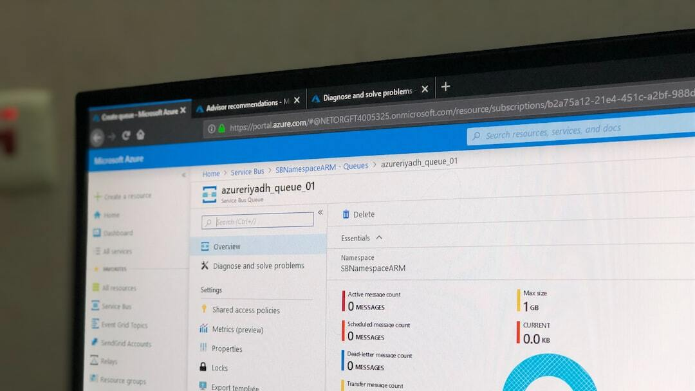
TestRail Software Overview
Description: An all-in-one tool for managing test repositories, creating test plans, tracking test execution progress, monitoring automation coverage, and generating insightful reports
Photo by Space Cracker on Unsplash

Slide 4
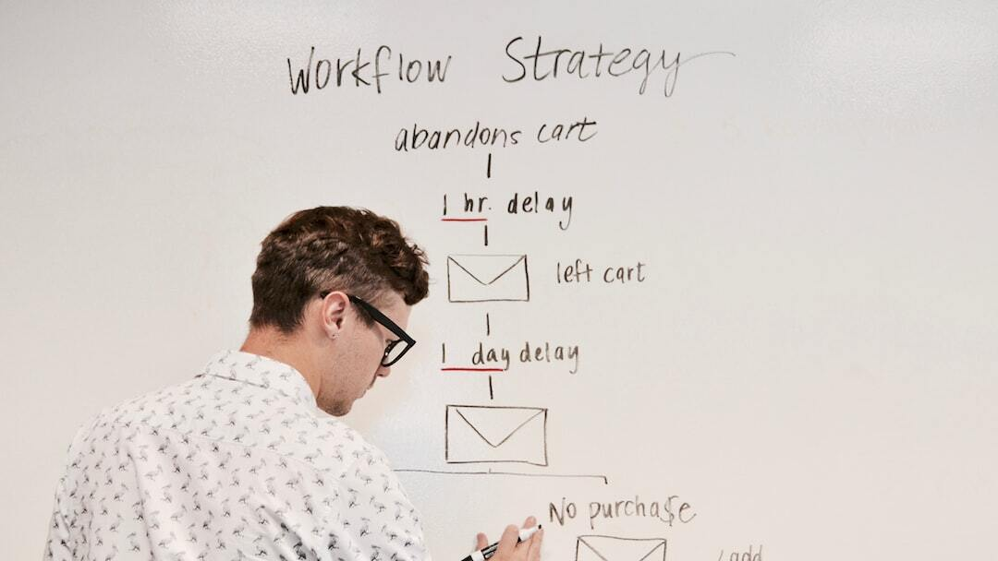
Strategy to Persuade
Build a compelling case for ROI:
Address stakeholder concerns:
Develop a phased implementation plan:
Secure internal champions:
Photo by Campaign Creators on Unsplash

Slide 5

ROI Calculation
Cost of Investment: $35,000
Estimated Benefits: $251,000
ROI (Year 1): 718.57%
Payback Period: 12 months
Photo by Kastriot Thaqi on Unsplash

Slide 6

Implementation Plan
Phase 1: Planning & Procurement
Phase 2: Setup & Configuration
Phase 3: Training & Onboarding
Phase 4: Pilot Testing
Phase 5: Full Rollout
Photo by Darius Bashar on Unsplash

Slide 7

Conclusion
Summary of the key points:
Reiteration of the recommendation to acquire the software:
Call to action for stakeholders to approve the proposal and initiate the implementation process:
Photo by Sarah Doody on Unsplash

